Slide 1
PROJECT TITLE: Protecting Patient Medical Data
PIP104 University Project-II
Review-1
Batch Number: G66
Roll Number | Student Name
20201CSE0370 | Bysani Lakshmi Narasimha Sai Lahari
20201CSE0386 | SD Amruthavalli
20201CSE0416 | Lingutla Thanusha
Under the Supervision of,
Dr. Prakash Shanmurthy
Assistant Professor
School of Computer Science & Engineering
Presidency University

Slide 2
Problem Statement
The problem is that updating privacy rules for shared health records is too complicated. As more people use third-party providers for managing health data, keeping this information secure becomes difficult. The research wants to make a simple system to update privacy rules for Personal Health Records (PHRs). The goal is to make it easy to manage who can access the records, improving data privacy and security without making things too hard for users or computers.

Slide 3
Introduction
In today’s digital age, storing patient medical records has become a cornerstone of modern healthcare. It is not only compliant but a fundamental commitment to protect sensitive patient data.
In the digital age where electronic health records and interconnected healthcare systems have become the norm, protecting sensitive patient data is of utmost importance.
In this presentation, we discuss the critical importance of keeping medical records confidential and secure. We will explore the challenges, ethical and legal obligations and solutions addressed by our final year project.

Slide 4
Literature Review
SNO | AUTHOR | TITLE | DESCRIPTION | TECHNIQUE | DATASET
1 | M.Azhagiri Amritha R.Aparna Jashmitha B | Secured Electronic Health Record Management System | This project attempts to protect the privacy of healthcare records from hackers and also viruses, Trojan horses etc. | SHA3 Algorithm | IEEE
2 | Siva Rama Krishnan S Manoj M.K Thippa Reddy Gadekallu | A Blockchain-Based Credibility Scoring Framework for Electronic Medical Records | Data stored on the Internet is not secure and requires an additional security framework to safeguard and maintain complete trust with the data. | CSA-based approach using blockchain | IEEE

Slide 5
Literature Review
SNO | AUTHOR | TITLE | DESCRIPTION | TECHNIQUE | DATASET
3 | Jomol Mathew Yan Luo Peilong Li | A Review of Secure and Privacy-Preserving Medical Data Sharing | This paper surveys the state-of-the-art schemes on secure and privacy preserving medical data sharing of the past decade with a focus on blockchain-based approaches. | Encryption Technique using Blockchain | IEEE

Slide 6
Proposed Method
Our proposed scheme is based on the cipher text policy attribute-based encryption (CP-ABE) and proxy re-encryption (PRE).
In addition, we introduce a policy versioning technique to support the full traceability of policy changes. Finally, we conducted the performance evaluation to demonstrate the efficiency of the proposed scheme .

Slide 7
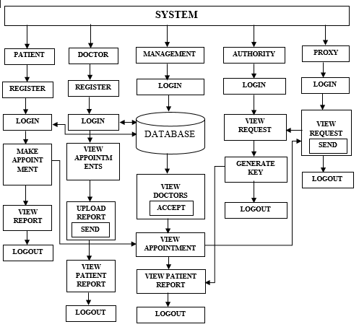
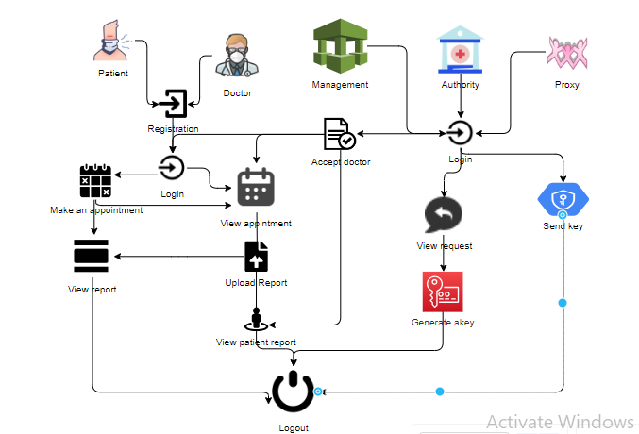
Proposed Architecture

Slide 8
Modules
PATIENT:
Login: Patient has to login with valid details which are used in his / her Registration.
Register: Each and every patient has to register.
Appointment: Patient will raise an appointment with symptoms.
View Report: Patient will view reports after his / her medical checkup. Medical Records of every Hospitals must be visible using there generated key.
View health history: patient can view their previous health data.
Logout: Finally, logout from the system.

Slide 9
Modules
AUTHORITY:
Login: Authority will login with default details
View Request: View all requests from proxy.
Generate Key: Generate Key to pass it to the authorized patient
Logout: Finally logout from the system.

Slide 10
Modules
PROXY SERVER:
Login: Authority will login with default details
View Request: View all requests from Doctors.
Send Request: Pass requests to the authority
Logout: Finally logout from the system.

Slide 11
Modules
DOCTOR:
Login: Doctor has to login with valid details which are used in his / her Registration
Register: Each and every patient has to register and management has to accept request.
View Appointment: View all the appointments
Upload Report: Uploads report.
Send File: Send’s file to the proxy
View Patient Report: patient will view all the reports of the patient.
Logout: Finally, logout from the system.

Slide 12
Modules
HOSPITAL MANAGEMENT:
Login: Management will login with default details, they can view the patients’ medical details without any key.
Appointment: Views all the appointments requests from the Patients
View Doctor Request: View all the doctor requests who are registered.
Send Information: Patient request will be passed to doctor
View Report :View Patient Report in Emergency cases.
Logout: Finally logout from the system.

Slide 13
Objectives
Protect patient data from unauthorized access.
Maintain confidentiality and trust with patients.
Monitor record access to ensure data security.

Slide 14
Methodology
Our methodology for safeguarding patient medical records is straightforward. It starts with following healthcare data privacy regulations, like GDPR to stay legally compliant.
Our approach includes strong data encryption, access controls, and real-time monitoring to ensure records security.
We also focus on educating healthcare staff and patients on best practices for data protection. Ongoing compliance checks and regular system maintenance keep everything up-to-date and secure.
This method aims to build trust, prevent data breaches, and adhere to legal and ethical standards in healthcare.

Slide 15
Timeline of Project
Project Initiation
Literature Review
Data Collection and Analysis
Develop Methodology
Project Implementation
Results and Recommendations
Final Presentation

Slide 16
Expected Outcomes
Enhanced data security for patient records.
Improved awareness of data security best practices among users.
Reduction in unauthorized access and costs related to data security.

Slide 17
Conclusion
In our project, focused on securing patient medical records. We've emphasized compliance with regulations, robust security, education, and continuous monitoring.
This project aims to ensure data safety, patient trust, and legal adherence. We look forward to upholding these principles and making a positive impact on healthcare.

Slide 18
References
Barrows RC Jr, Clayton PD. Privacy, confidentiality, and electronic medical records. J Am Med Inform Assoc. 1996;3:139–148.
Y. Kawai, ‘‘Outsourcing the re-encryption key generation: Flexible ciphertext-policy attribute-based proxy re-encryption,’’ in Proc. Int. Conf. Inf. Secur. Pract. Exper. (ISPEC), Beijing, China, 2015, pp. 301–315.
L. Touati and Y. Challal, ‘‘Instantaneous proxy-based key update for CPABE,’’ in Proc. IEEE 41st Conf. Local Comput. Netw. (LCN), Dubai, United Arab Emirates, Nov. 2016, pp. 591–594.
K. Yang, X. Jia, and K. Ren, ‘‘Secure and verifiable policy update outsourcing for big data access control in the cloud,’’ IEEE Trans. Parallel Distrib. Syst., vol. 26, no. 12, pp. 3461– 3470, Dec. 2015.

Slide 19
Thank You

